Slide 1

Y4D - Build a Career Tracking Platform For Skilled Youth
Team 18

Slide 2

Problem Statement Brief
Organizations invest heavily in talent—scholars, interns, and new hires.
After their initial program, tracking career progression is manual, costly, and inefficient.
Valuable data becomes trapped in static spreadsheets, leading to outdated information and missed opportunities.
The Core Problem: A growing "Engagement Gap" that prevents mentorship, networking, and a clear view of long-term impact.

Slide 3
Solution Overview
The Living Profile:
Transforms manual data handling to semi-auto-updating profile system.
Creates a living ecosystem that tracks the entire scholar journey.
The Smart Detective:
An integrated LinkedIn scraper for automated data enrichment.
Intelligent Curation:
A pre-upload filter that automatically removes stale data from scraped excel results.
Focuses on active alumni by filtering out long-inactive LinkedIn profiles.
Notifies inactive users to encourage re-engagement.
Smart Sync:
An effortless bulk Excel upload feature to update hundreds of records in minutes.
Intelligently recognizes existing scholars and updates their details, preventing duplicates and ensuring data integrity.

Slide 4
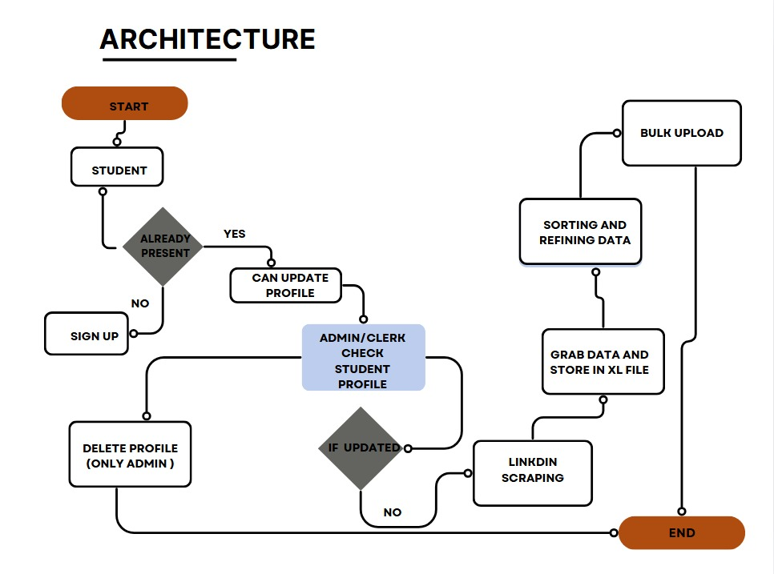
Solution Architecture

Slide 5
Demo
https://drive.google.com/file/d/11am4coOzO9qZndruPMW-pVP8sny_yw2Y/view?usp=sharing

Slide 6
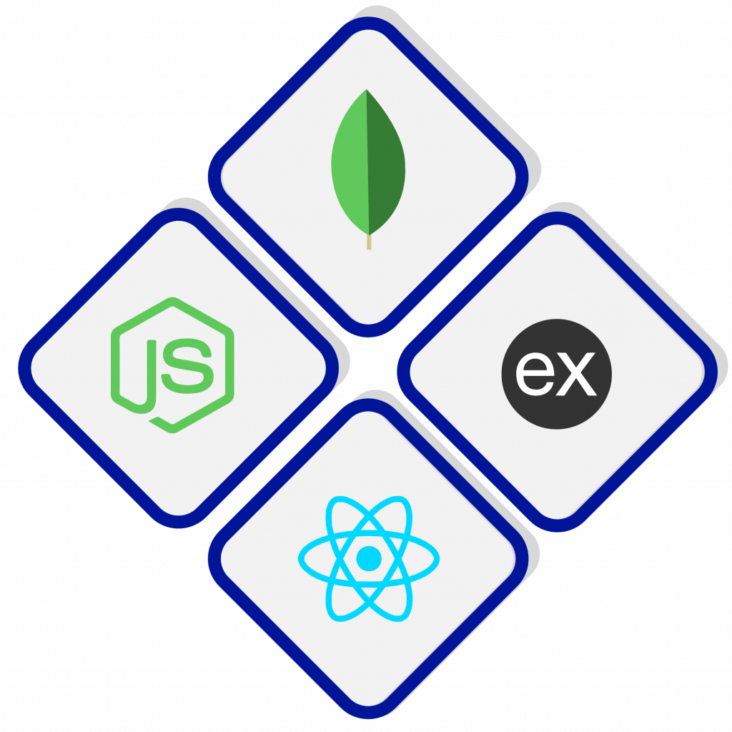
Technology Stack
Backend: Robust and secure APIs built with Node.js and Express.
Database: Flexible and scalable NoSQL database with MongoDB.
Frontend: A dynamic and responsive user interface built with React.

Slide 7
Future scope
Cloud-Native Scalability:
Migrate to AWS for enhanced reliability and global reach.
Implement AWS Load Balancers and Auto-Scaling instances to handle high traffic and ensure zero downtime.
Microservice Architecture:
Evolve the application into independent microservices (e.g., User Service, Scraping Service) for better scalability and easier maintenance.
Advanced AI & Analytics:
Integrate with BI tools like Power BI for sophisticated data dashboards.
Develop an AI-powered feature to suggest ideal mentor-scholar pairings.

Slide 8
Q&A

